Slide 1
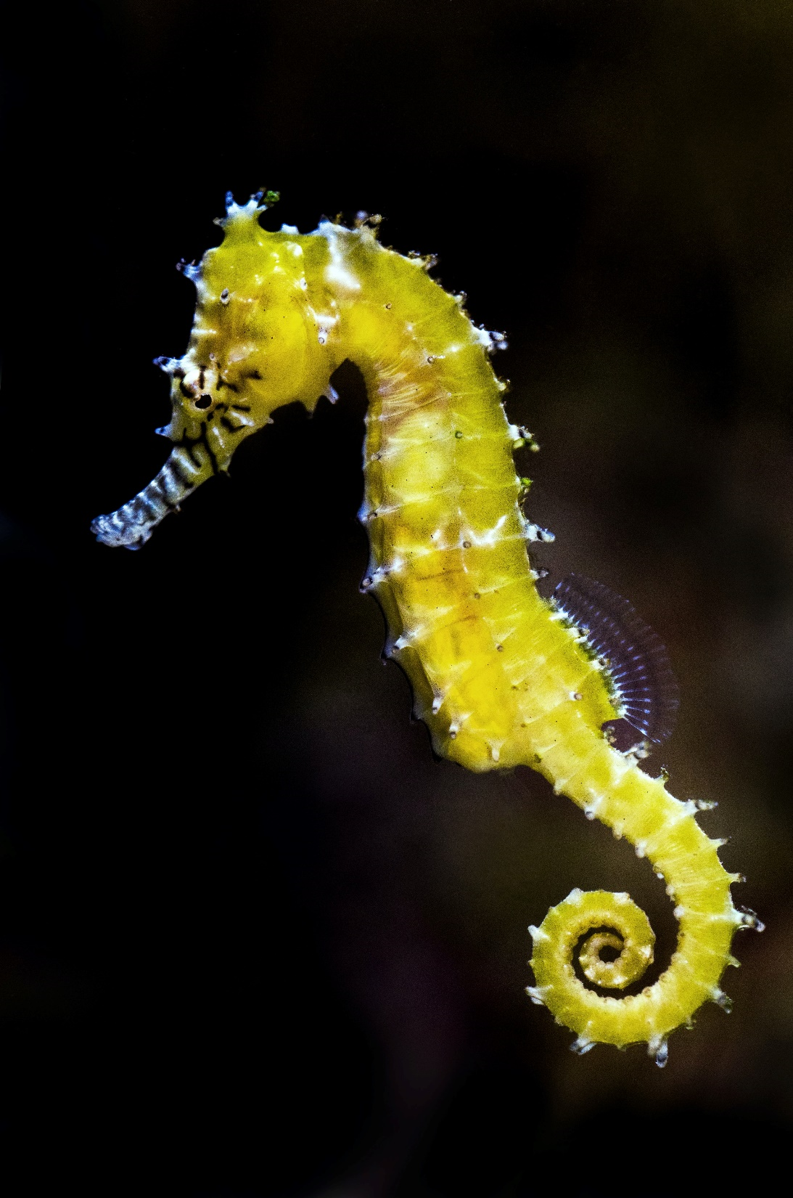

SEAHORSES
COMMON NAME: Seahorses
SCIENTIFIC NAME: Hippocampus
TYPE: Fish
DIET: Carnivore
GROUP NAME: Herd
AVERAGE LIFE SPAN IN THE WILD: 1 to 5 years
SIZE: 0.6 to 14 inches

Slide 2
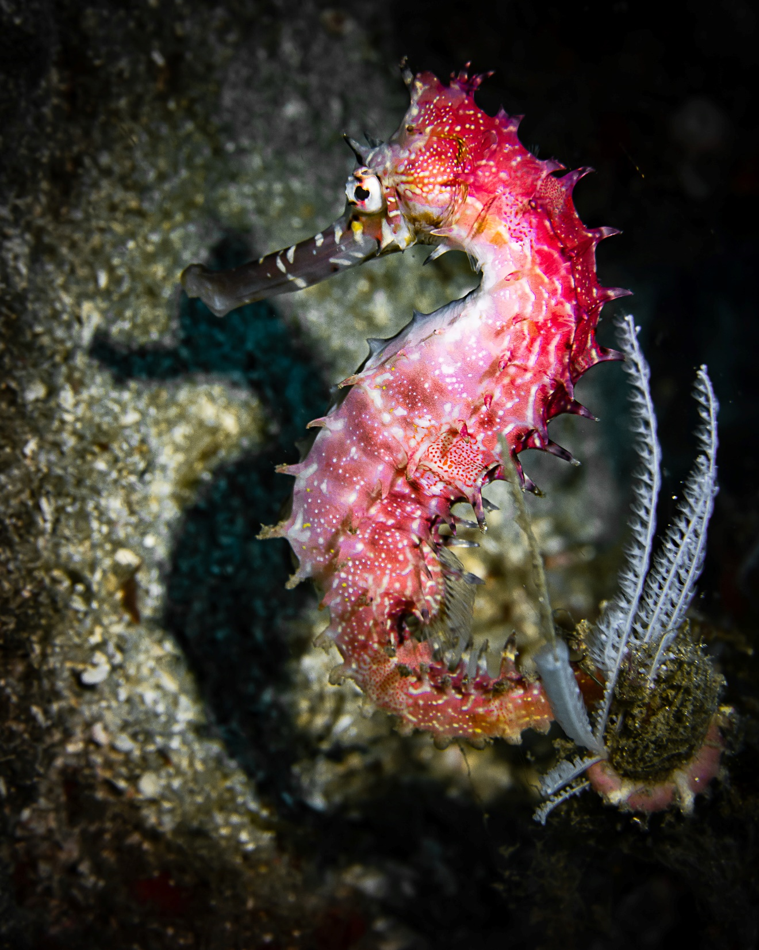
WHERE TO FIND !
You’ll find seahorses in the world’s tropical and temperate coastal waters, swimming upright among seaweed and other plants.

Slide 3
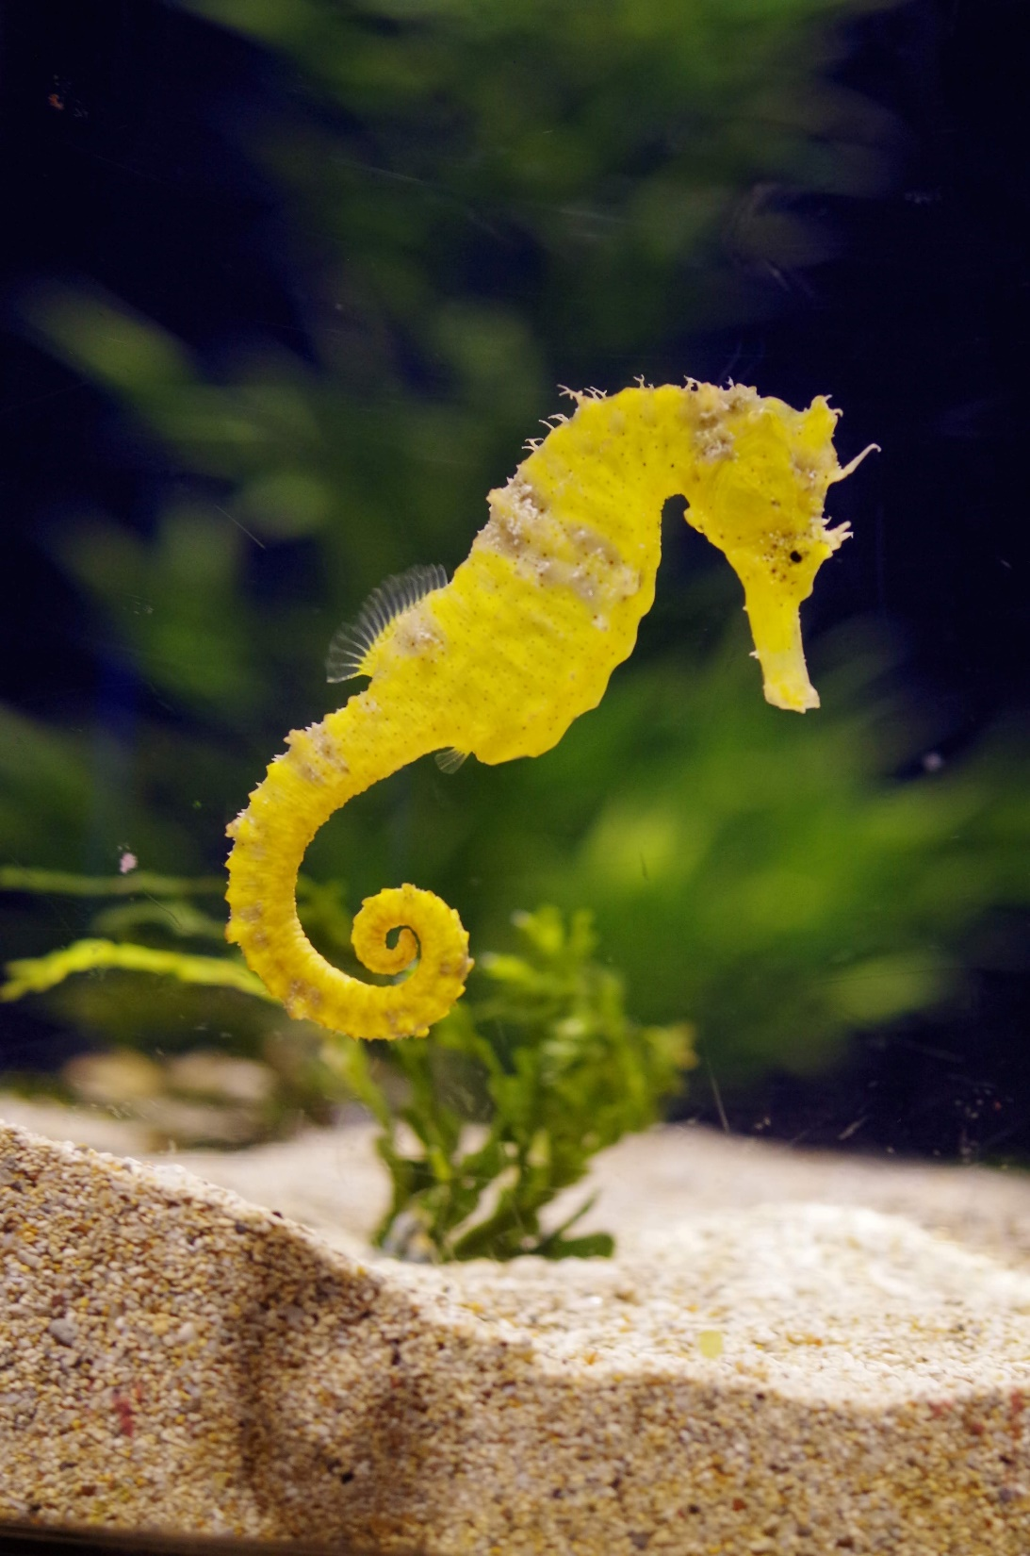
HOW DO THEY MOVE !
Seahorses use their dorsal fins to propel slowly forward.

Slide 4
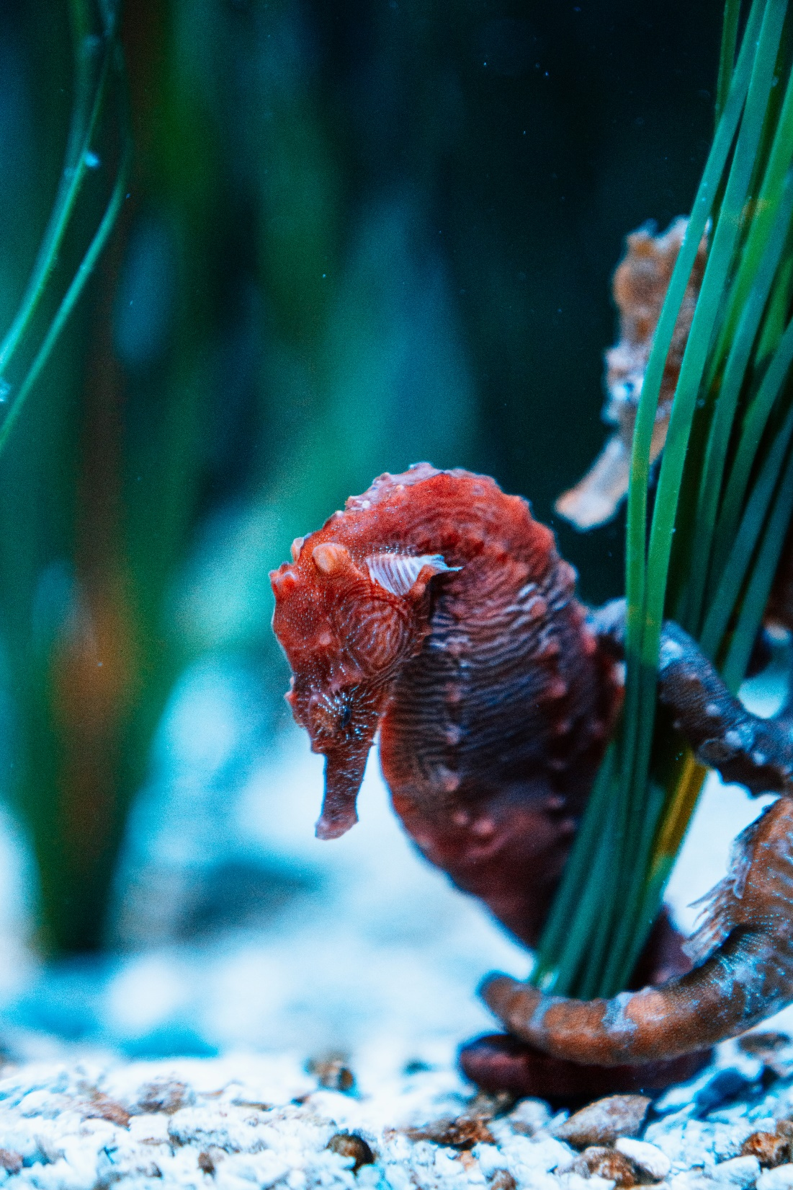
BREEDING
The male seahorse carries the eggs in his pouch for 2 to 3 weeks before giving birth.
They can have as many as 2,000 babies at a time.

Slide 5
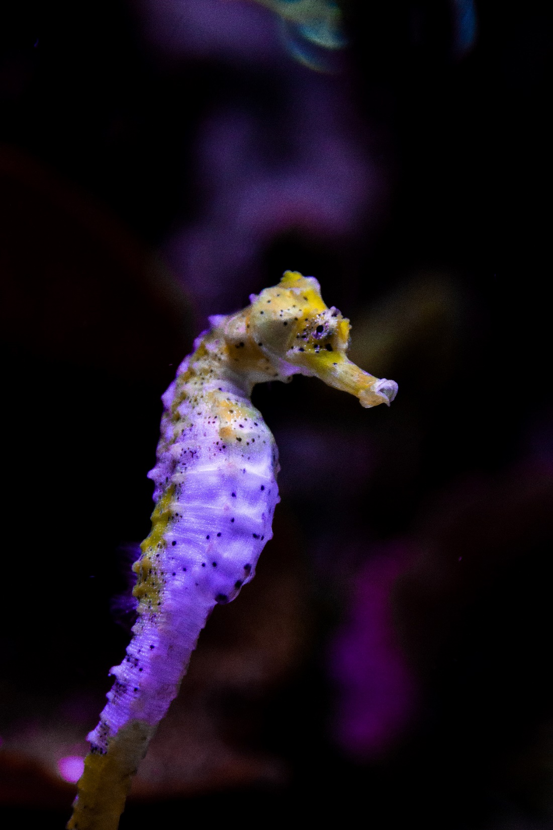
Communicating and surviving
They used their tails to call each other, Unlike kangaroos, baby seahorses do not return to the pouch. They must find food and hide from predators as soon as they’re born.

Slide 6
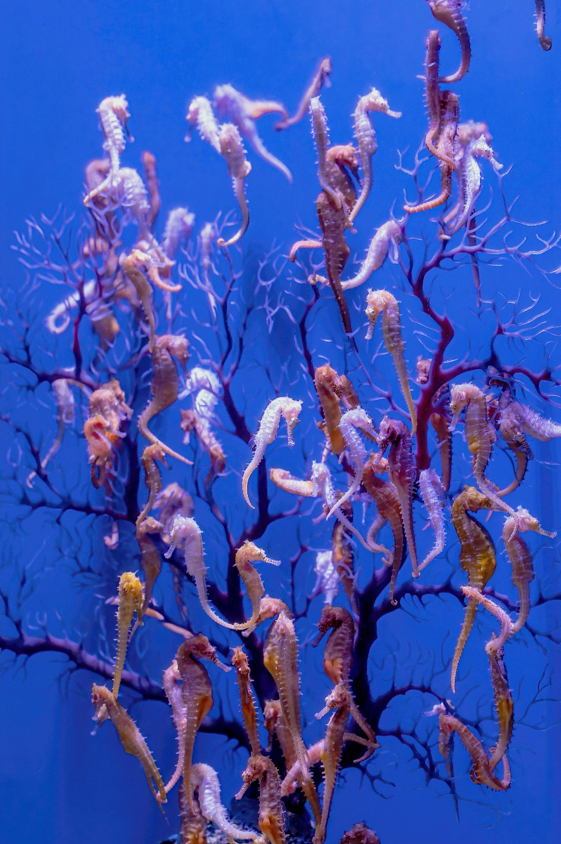
Extinction
There are 47 species of seahorses, but sadly seahorses going to extinct, Because of the Climate change and the human mistakes such as pollutions.

Slide 7
Please Help To Save Seahorses
(The End)

